Slide 1
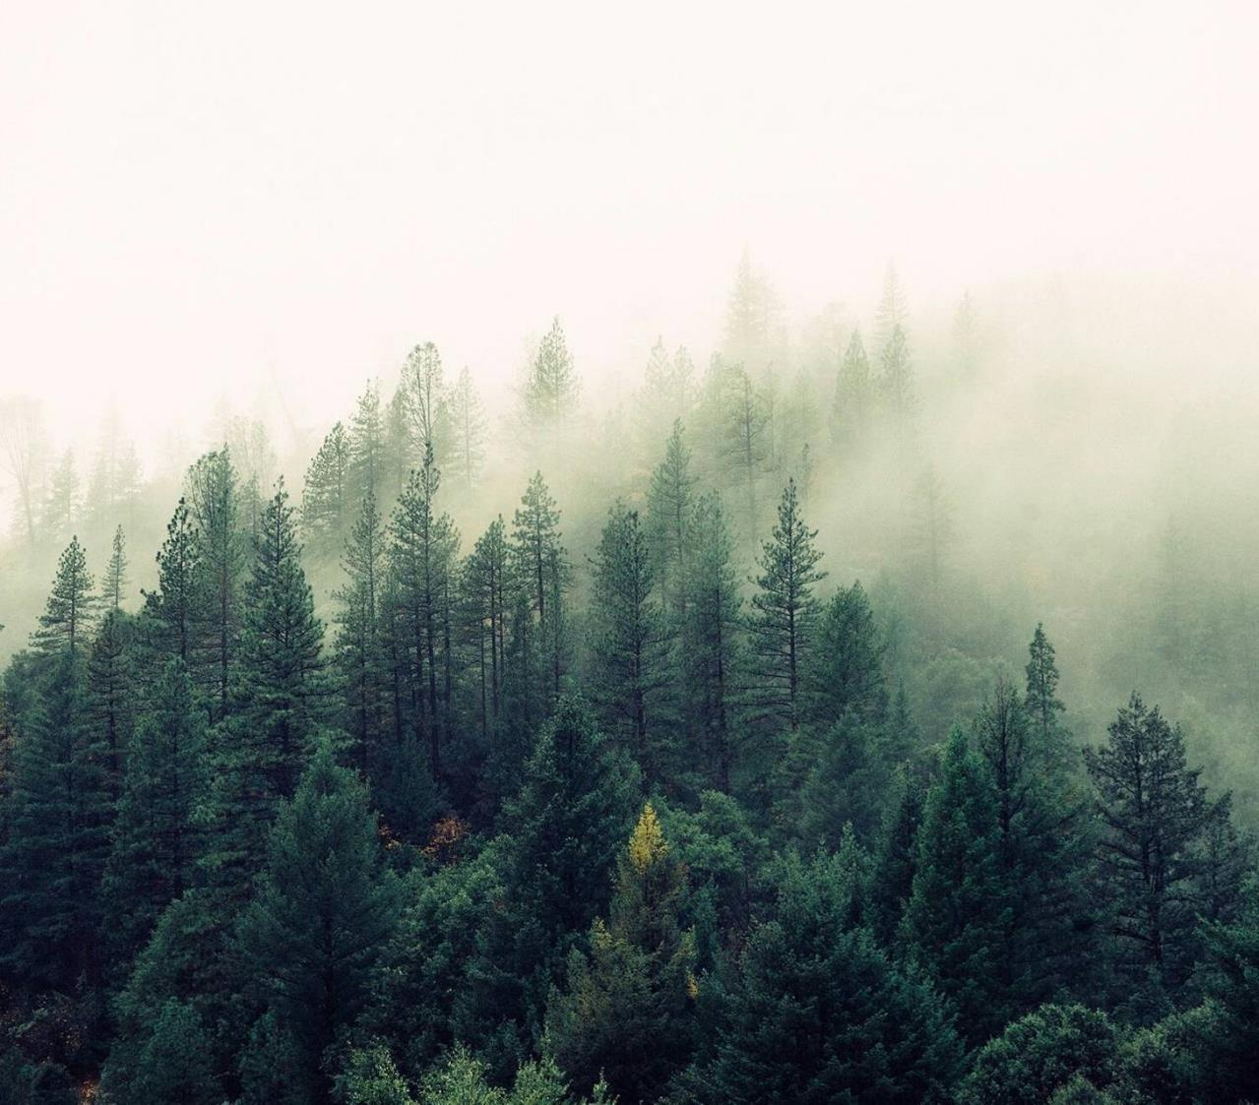
FOREST ECOSYSTEM
ARYAN chaudhary
500105282
Aiml-h-b1

Slide 2
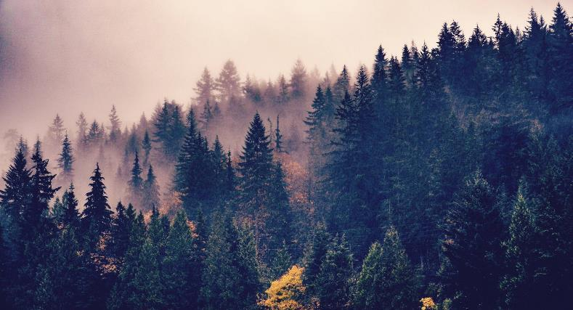
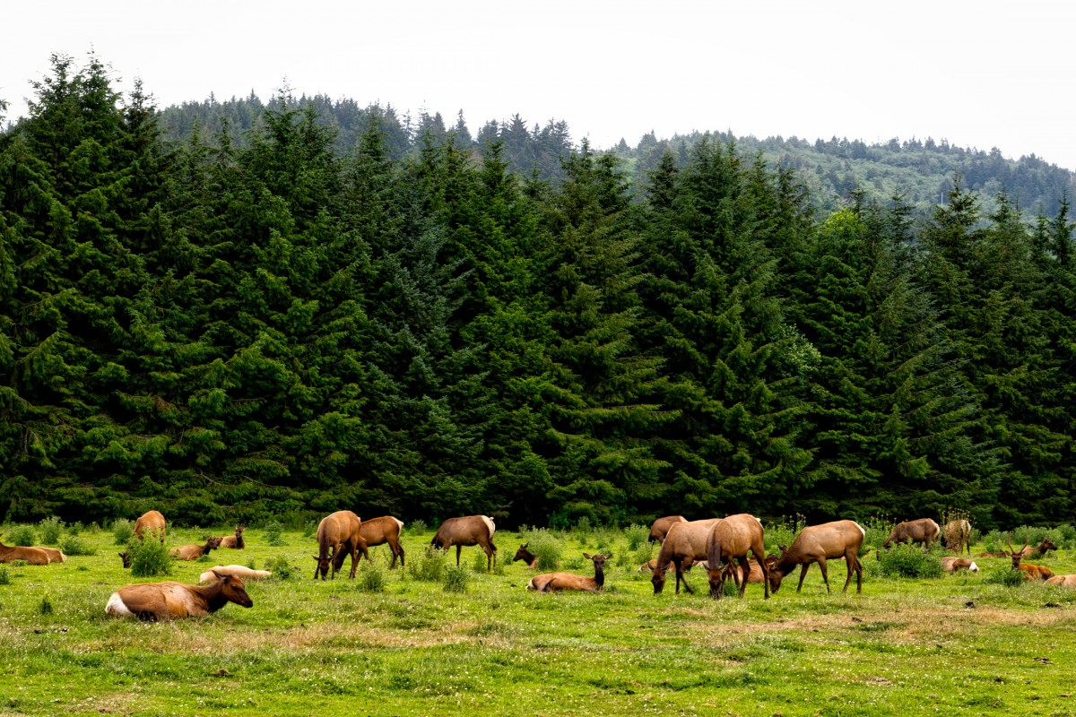
INTRODUCTION
A forest ecosystem is made up of a diverse range of living things, their natural surroundings, and the complex relationships that exist among them in a forest.
Key elements of forest ecosystem:
Abiotic Components- It includes Soil and climate(temperature,humidity,sunlight,etc.)
Biotic Components-It includes Producers(plants), Consumers(animal) and decomposers(microorganism).
Food Web- Interconnected Food Chain.
Biodiversity
Water Cycle, etc

Slide 3
AGENDA
Title:
Agent-Based Modeling of Forest Ecosystems: Creating agent-based models to simulate and analyse forest ecosystems, studying biodiversity and ecosystem dynamics.
PROBLEM STATEMENT:
Increasing human activities like urbanization and agricultural expansion is resulting in extensive deforestation and habitat fragmentation in most of the forests,compromising their biodiversity, ecosystem services, and overall ecological integrity. The accelerated rate of land conversion is increasing the vulnerability of native flora and fauna, disrupting essential ecological processes, and contributing to the loss of critical habitats for numerous species. Moreover, the disconnection of fragmented forest patches is impeding the natural movement of wildlife, leading to genetic isolation and reducing the adaptive capacity of the ecosystem to environmental changes.

Slide 4
MAIN OBJECTIVE
The main objective of this research is to assess the impact of human activities, particularly urbanization and agricultural expansion, on the spatial dynamics of deforestation and habitat fragmentation in the Forests.

Slide 5
VISION
1.TO DEVELOP AN AGENT-BASED SIMULATION TO OPTIMIZE THE PROBLEM OF DESTRUCTION CAUSING DUE TO VARIOUS HUMAIN ACTIVITIES IN FOREST ECOSYSTEM
2. USING APPROPRIATE MODELLING APPROACH TO OPTIMIZE FOREST CONSERVATION STRATEGIES
3. ALGORITHM, TOOLS,TECHNIQUES AND COMPUTATIONS
4. CONCLUSION DRAWN FROM THE TECHNIQUES

Slide 6
AGENT BASED MODELLING
ABM provides a flexible and powerful approach to simulate and analyze complex systems by representing individual decision-making entities(agents) and their interactions within the system. It allows for the exploration of emergent phenomena, the impact of individual behaviors on the system as a whole, and the study of how global patterns arise from local interactions.
Agent Based Model can be developed to stimulate the impact of human activities particularly the urbanization and agricultural expansion on the spatial dynamics of deforestation and habitat fragmentation.
The ABM can incorporate various types of agents, such as trees, animals, and humans, and their interactions within the ecosystem.
The model can simulate the impact of human activities on the forest ecosystem, such as the loss of biodiversity, the disruption of ecological processes, and the reduction of critical habitats for numerous species

Slide 7
MONTE CARLO SIMULATION
Agent Based Modelling uses Monte Carlo methods to understand the stochastic (random) aspects of the models.
Monte Carlo simulation is a computer technique used to model complex systems or processes by generating random samples of input variables according to their probability distributions. It allows for the analysis of uncertainty and variability in system behavior and for making judgments about results or outcomes based on repeated random sampling.
When studying the effects of human activities on forests, various factors such as the degree of urbanization, agricultural expansion, deforestation probability, habitat fragmentation thresholds and ecological responses can be modeled using Monte Carlo simulation. By generating random samples of these variables and simulating forest dynamics over time, Monte Carlo simulation allows researchers to explore different scenarios and assess the potential ecological effects of human activities on forest ecosystems..

Slide 8
Monte Carlo simulation can be used to:
Generate random samples of urbanization and agricultural expansion rates.
Calculate deforestation probabilities based on these rates and other parameters.
Simulate forest cover change over time, incorporating deforestation events probabilistically.
Evaluate the extent of habitat fragmentation and its impact on biodiversity and ecosystem resilience.
By repeating the simulation multiple times with different sets of random samples, Monte Carlo simulation provides a probabilistic estimate of possible outcomes and allows researchers to quantify the uncertainty associated with human-induced forest change. This information can help in decision-making processes, conservation strategies and land use planning aimed at mitigating the negative effects of urbanization and agricultural expansion on forest ecosystems.

Slide 9
ALGORITHM
Aryan_Forest_Cover_Change_model(forest_cover,urbanization_rate,agricultural_expansion_rate,Deforestation_probability,fregmentation_threshold,Time_steps)
Parameters:
Set initial_forest_cover as the starting forest cover percentage.
Define urbanization_rate as the annual increase in urban area (%).
Specify agricultural_expansion_rate as the annual increase in agricultural land (%).
Set human_impact as a parameter representing the overall human impact on deforestation (a value between 0 and 1).
Set fragmentation_threshold as the minimum forest patch size to avoid fragmentation (%).
Set time_steps as the number of time steps to simulate.
Initialize Variables:
Initialize forest_cover as initial_forest_cover
Initialize fragmented_area as 0.

Slide 10
Monte Carlo Simulation Loop:
Repeat the following steps for each time step from 1 to time_steps:
Simulate urbanization_loss:
Generate random number random_number1 between 0 and 1.
Calculate urbanization_loss= urbanization_rate ×random_number1
Forest_cover = Forest_cover-urbanization_loss [forest change due to urbanization]
Simulate agricultural_expansion_loss:
Generate another random number random_number2 between 0 and 1.
Calculate agricultural_expansion_loss=Agricultural_expansion_rate×random_number2.
Forest_cover= Forest_cover-Agricultural_expansion_loss
Total_forest_cover_change= Initial_Forest_cover-Urbanization_loss-Agricultural_expansion_loss
Deforestation probability based on human impact:
deforestation_probability=(agricultural_expansion_loss+urbanization_loss)×human_impact
Simulate deforestation:
For each combination of urbanization and agricultural expansion loss Repeat:
Generate random_number3 such that random_number3 is uniformly distributed in the range [0, 1].
If Random_number3 < deforestation_probability then
forest_cover=forest_cover−1

Slide 11
Evaluate habitat fragmentation:
Calculate fragmented_patches:
Fragmented_patches = forest_cover/fragmentation_threshold(integer division).
[Here,"fragmented patches" refer to the number of discrete, separated areas of forest cover remaining after considering the fragmentation threshold. It's a measure used to assess how the forested area is broken up into smaller patches due to various factors like deforestation, urbanization, and agricultural expansion.]
Calculate fragmented_area:
fragmented_area=fragmented_patches×fragmentation_thresold.
[Here,"fragmented area" refers to the total area of forest that is divided into fragmented patches, where each patch size is determined by the fragmentation threshold. It's a measure used to quantify the extent of habitat fragmentation resulting from deforestation, urbanization, agricultural expansion, and other factors.]

Slide 12
CODE IN C
#include <stdio.h>
#include <stdlib.h>
#include <time.h>
int main() {
// Initialize Parameters
double initial_forest_cover = 70.0; // Initial forest cover percentage
double urbanization_rate = 1.5; // Annual increase in urban area (%)
double agricultural_expansion_rate = 1.0; // Annual increase in agricultural land (%)
double human_impact = 0.7; // Overall human impact on deforestation
double fragmentation_threshold = 5.0; // Minimum forest patch size to avoid fragmentation (%)
int time_steps = 10; // Number of time steps to simulate
// Initialize Variables
double forest_cover = initial_forest_cover;
double fragmented_area = 0.0;
// Seed random number generator
srand(time(0));
// Monte Carlo Simulation Loop
for (int step = 1; step <= time_steps; step++) {
// Simulate urbanization loss
double urbanization_random = (double)rand() / RAND_MAX;
double urbanization_loss = urbanization_rate * urbanization_random;
forest_cover -= urbanization_loss;

Slide 13
// Simulate agricultural expansion loss
double agricultural_random = (double)rand() / RAND_MAX;
double agricultural_expansion_loss = agricultural_expansion_rate * agricultural_random;
forest_cover -= agricultural_expansion_loss;
// Calculate deforestation probability
double deforestation_probability = (agricultural_expansion_loss + urbanization_loss) * human_impact;
// Simulate deforestation
double deforestation_random = (double)rand() / RAND_MAX;
if (deforestation_random < deforestation_probability) {
forest_cover -= 1;
}
// Evaluate habitat fragmentation
int fragmented_patches = forest_cover / fragmentation_threshold;
fragmented_area = fragmented_patches * fragmentation_threshold;
// Output forest cover and fragmented area for each time step
printf("Time Step %d - Urbanization Loss: %.2f%%, Agricultural Loss: %.2f%%, Forest Cover: %.2f%%, Fragmented Area: %.2f%%\n", step, urbanization_loss, agricultural_expansion_loss, forest_cover, fragmented_area);
}
return 0;
}

Slide 14
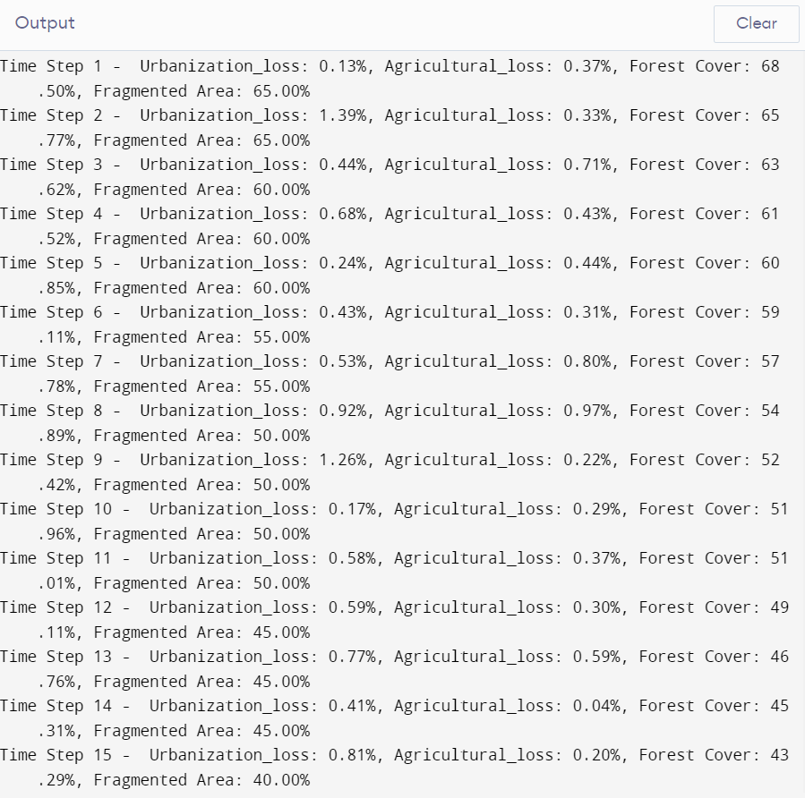
OUTPUT

Slide 15
Result & Conclusion
Forest Cover loss: As a result of the combined effects of urbanization and agricultural growth, the simulation is expected to depict a gradual loss in forest cover over time.
Increased Fragmentation: As forest cover decreases, the simulation may also reveal an increase in habitat fragmentation, where remaining forest patches become smaller and more isolated. This fragmentation results from the expansion of urban areas and agricultural lands, leading to the division of continuous forest habitats into fragmented patches.
Policy implications: The simulation results highlight the importance of implementing effective land use management and conservation measures to reduce the negative impacts of urbanization and agricultural expansion on forest ecosystems wom so emphasize

Slide 16
Environmental impacts: Decreasing forest cover and increasing fragmentation can have significant environmental impacts, e.g.
Biodiversity loss: Habitat fragmentation can lead to biodiversity degradation by reducing habitat quality and restricting the movement of wildlife species
Ecosystem damage: Fragmented habitats disrupt environmental processes such as nutrient cycling, pollination, and seed dispersal, affecting ecosystem function and resilience
Future directions: Further research and modeling efforts are needed to examine new scenarios, evaluate the effectiveness of conservation strategies, and create evidence-based decisions for sustainable forest management and land use role planning. By incorporating socioeconomic factors, stakeholder preferences, and ecosystem dynamics into future projections, we can develop comprehensive models to address the complex interactions between human activities and forest ecosystems between living things.
We can conclude that by analysing these result of Total_Forest_cover_change and Fregmented_area we can apply various measure that can prevent changes or destruction that are prevailing in forest ecosystem.

Slide 17
REFERENCES & CITATIONS
The accelerated rate of land conversion is increasing the vulnerability of native flora and fauna, disrupting essential ecological processes, and contributing to the loss of critical habitats for numerous species (Pendrill et al., 2022). Moreover, the disconnection of fragmented forest patches is impeding the natural movement of wildlife, leading to genetic isolation and reducing the adaptive capacity of the ecosystem to environmental changes (Haddad et al., 2015).
References: Pendrill, F., Gardner, T., Meyfroidt, P., Persson, U. M., Adams, J., Azevedo, T., ... West, C. (2022). Disentangling the numbers behind agriculture-driven tropical deforestation. Science, 377. Haddad, N., Brudvig, L., Clobert, J., Davies, K., Gonzalez, A., Holt, R., ... Townshend, J. (2015). Habitat fragmentation and its lasting impact on Earth’s ecosystems. Science Advances, 1.
The citation for "Uniform Distribution" is most relevant in the context of the algorithm. Here is the citation inserted in the relevant part of the context: "Random Number Generation: To simulate uncertain events or parameters, random numbers are generated from a uniform distribution within a specified range. In the provided algorithm, random numbers between 0 and 1 are generated to model uncertainty in urbanization loss, agricultural expansion loss, and deforestation probability" (Deshpande et al., 2021). References: Deshpande, A., Niroula, P., Shtanko, O., Gorshkov, A., Fefferman, B., & Gullans, M. (2021). Tight Bounds on the Convergence of Noisy Random Circuits to the Uniform Distribution. PRX Quantum.

Slide 18
The Monte Carlo Simulation used in the model can be cited from the following reference: Kawrakow, I., Mainegra-Hing, E., & Tessier, F. (2016). The EGSnrc Code System: Monte Carlo Simulation of Electron and Photon Transport. References: Kawrakow, I., Mainegra-Hing, E., & Tessier, F. (2016). The EGSnrc Code System: Monte Carlo Simulation of Electron and Photon Transport.
Forest Ecosystem Modelling for Policy Planning May 2023 DOI:10.1007/978-981-99-0131-9_24Authors: Karun jose,Arya .A,Rajiv kumar chaturvedi,Aritra bandopadhyay
Biodiversity and Ecosystem Functions Across an Afro-Tropical Forest Biodiversity Hotspot February 2022 DOI:10.3389/fevo.2022.816163 Author: Tobais seifert,mike taucher,werner ulrich,felistas mwania
@Article Quoc2023FactorsAW, author = Canh Tran Quoc and Thang Tran Nam and C. Kull and Loi Nguyen Van and Tai Tien Dinh and R. Cochard and R. Shackleton and D. Ngo and Van Nguyen Hai and Pham Thi Phuong Thao , booktitle = Journal of Forest Research , journal = Journal of Forest Research , pages = 159 - 167 , title = Factors associated with deforestation probability in Central Vietnam: a case study in Nam Dong and A Luoi districts , volume = 28 , year = 2023
@Article Haddad2015HabitatFA, author = N. Haddad and L. Brudvig and J. Clobert and K. Davies and Andrew Gonzalez and R. Holt and T. Lovejoy and J. Sexton and M. Austin and Cathy D Collins and W. Cook and Ellen I. Damschen and R. Ewers and B. Foster and Clinton N. Jenkins and A. J. King and W. Laurance and D. Levey and C. Margules and B. Melbourne and A. O. Nicholls and John L. Orrock and D. Song and J. Townshend , booktitle = Science Advances , journal = Science Advances , title = Habitat fragmentation and its lasting impact on Earth’s ecosystems , volume = 1 , year = 2015
@Article Batala2023TheIO, author = Lochan Kumar Batala and Jiajun Qiao and Kalpana Regmi and Weiwen Wang and Abdul Rehman , booktitle = Clean Technologies and Environmental Policy , journal = Clean Technologies and Environmental Policy , pages = 2845 - 2861 , title = The implications of forest resources depletion, agricultural expansion, and financial development on energy demand and ecological footprint in BRI countries , volume = 25 , year = 2023
@Article Chen2022DoesEC, author = Hao Chen and Evelyn Agba Tackie and Isaac Ahakwa and Mohammed Musah and Andrews Salakpi and Morrison Alfred and Samuel Atingabili , booktitle = Environmental science and pollution research international , journal = Environmental Science and Pollution Research , pages = 37598 - 37616 , title = Does energy consumption, economic growth, urbanization, and population growth influence carbon emissions in the BRICS? Evidence from panel models robust to cross-sectional dependence and slope heterogeneity , volume = 29 , year = 2022
Ecosystem functioning, services and biodiversity during the ecological restoration (With special attention to forest ecosystem) DOI:10.13140/2.1.3345.6646 Author: Majid Yousefi Valikchali Leila Darvishi Mohammad Reza Pourmajidian

Slide 19
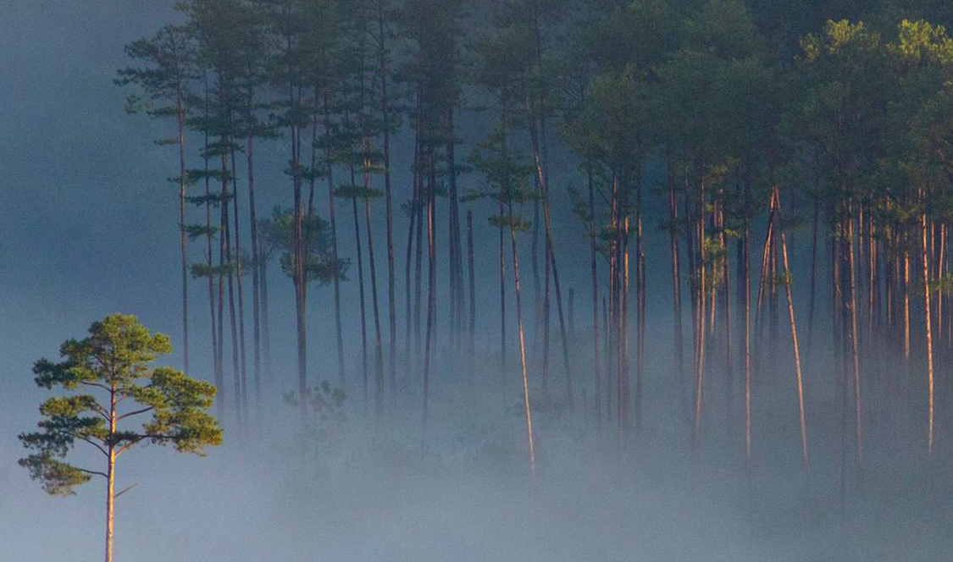
Thank you

